Slide 1







Efficient Federated Learning for Modern NLP
The 29th Annual International Conference On Mobile Computing And Networking
Dongqi Cai¹, Yaozong Wu¹, Shangguang Wang¹, Felix Xiaozhu Lin², Mengwei Xu¹
1 Beiyou Shenzhen Institute
2 University of Virginia
Notes:
Hello, my name is Dongqi Cai. // I'm from Beiyou Shenzhen Institute.
Thanks for Dr. ben’s introduction. It’s a great honor to stand here and very happy to see that so many of you are still here even it is the last session. Thank you
// Today, I'm here to present our wrok "Efficient Federated Learning for Modern NLP". //
This work was done in collaboration with a master student, Yaozong, // and three great professors: // Shangguang, Felix, and Mengwei. //
So, let's get started.
---
Hello, my name is dongqi cai, I’m from Beiyou Shenzhen institude. And I am here to present our paper: Efficient Federated Learning for Modern NLP.
This work was done in collaboration with a master student yaozong and three great professors shangguang, felix lin and memgwei.
So let’s get started
一个是速度，一个是main idea部分，每个词的最后一个语调是往下的。要讲的high一点！自己都不high，怎么能指望别人high呢
有些需要停顿的时候，要停一下。
资助号是挂到哪个课题下？
动画可以更生动一些：很简洁，字很少，一页上有很多东西。
需要断句的地方，都换行
需要点击动画的地方，写个click
可以不标号。caption可以短一些
如果听不懂的话，可以说，it’s a good question, I need to think more about it. Maybe we could talk about it later.

Slide 2

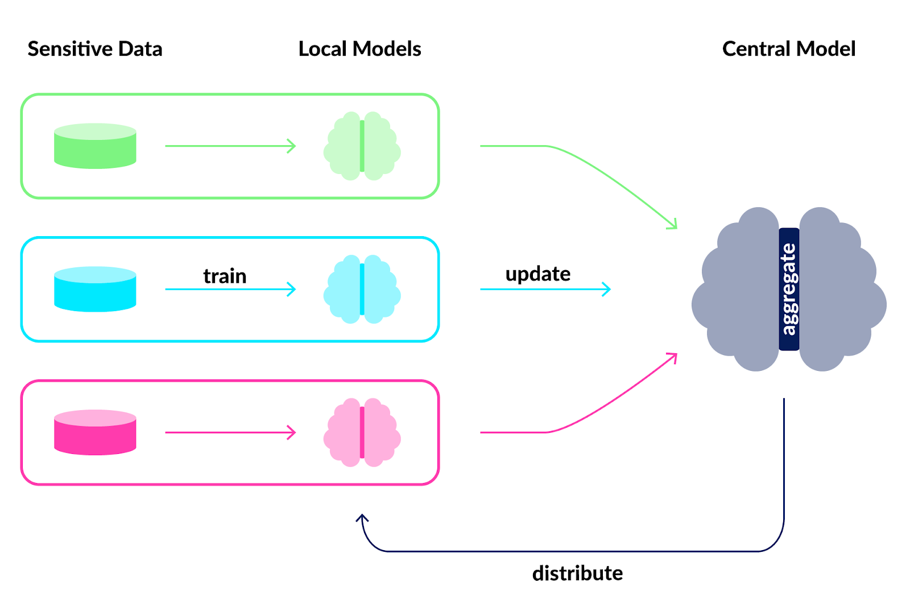



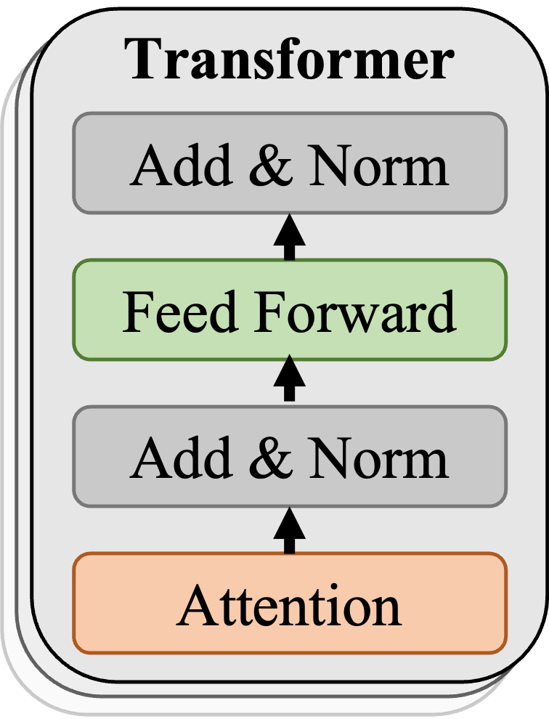
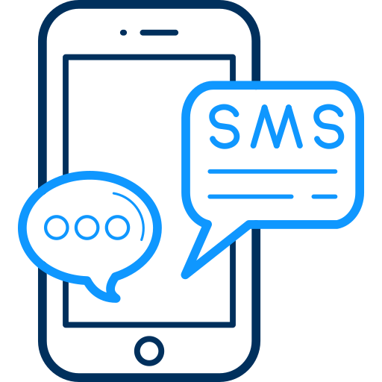

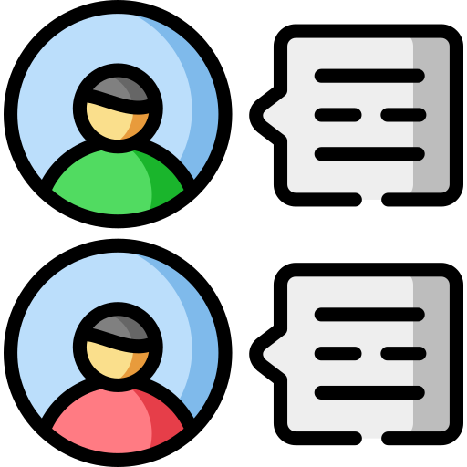
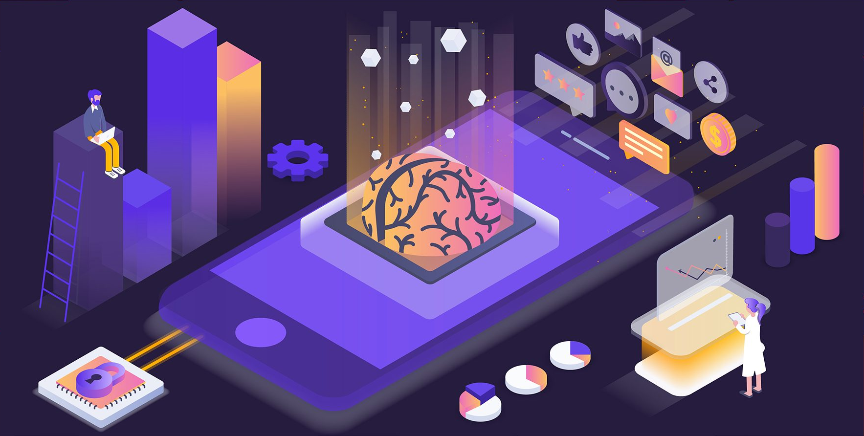
How to understand the meaning of a word?
Natural Language Processing (NLP)
Analyze
What sparks modern NLP?
Attention-based Transformer
Q&A
Type
Federated Learning: A Guide to Collaborative Training with Decentralized Sensitive Data (inovex.de)
How to preserve the privacy of training data?
Federated Learning
Notes:
So is there a way to preserve the privacy of training data? // That's federated learning.
Actually, I thought I could save the effort about introducing federated learning because I am the second paper in this session, but as you know, I’m the first one now, so never think about being lazy. fate will always find its way.
Okay, let me introduce federated learning quickly.
Federated learning lets clients with private data to train their model locally, and send the model for aggregating instead of sending the private data.
It is just a little bit similar to the traditional distributed learning, so don’t take it as a mystery. For more information about it, please checkout our paper, and we provide several good surveys about it.
Natural language processing, or NLP, // helps computers understand words automatically. //
Transformer-based models have changed the game in modern NLP. // Now, these models can do amazing things on our mobile devices, such as analyzing feelings in text, helping with typing, and even answering questions. //
But when we want these models to learn specific tasks, // we need private client data to train the model. (click)
//
**Which XX has just done a great presentation about it, so maybe I don’t need to introduce it again.
---
Natural language processing is traditional technique to make computer understand the meaning of a word automatically.
Transformer-based pre-trained models have revolutionized NLP for superior performance and generality. , modern NLP models show compelling use cases on client devices. Examples include sentiment analysis, QA, and auto completion.
Fine-tuning pre-trained models for downstream tasks often requires private data, for which federated learning is the de-facto approach
---
a cloud service selects multiple clients to participate in training. A client trains a local copy of the model with its private data and sends the model updates to the cloud. Having aggregated model updates from multiple clients, the cloud sends an updated model to the clients. The training procedure repeats many rounds (typically hundreds or thousands [51, 67, 81]) until the model accuracy reaches a desired level,

Slide 3
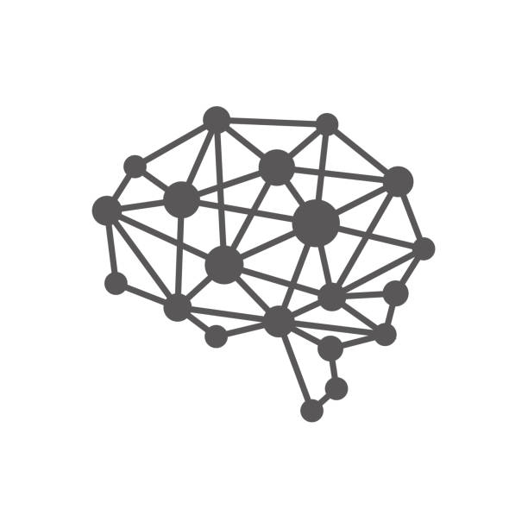
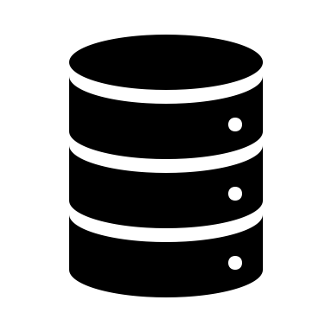
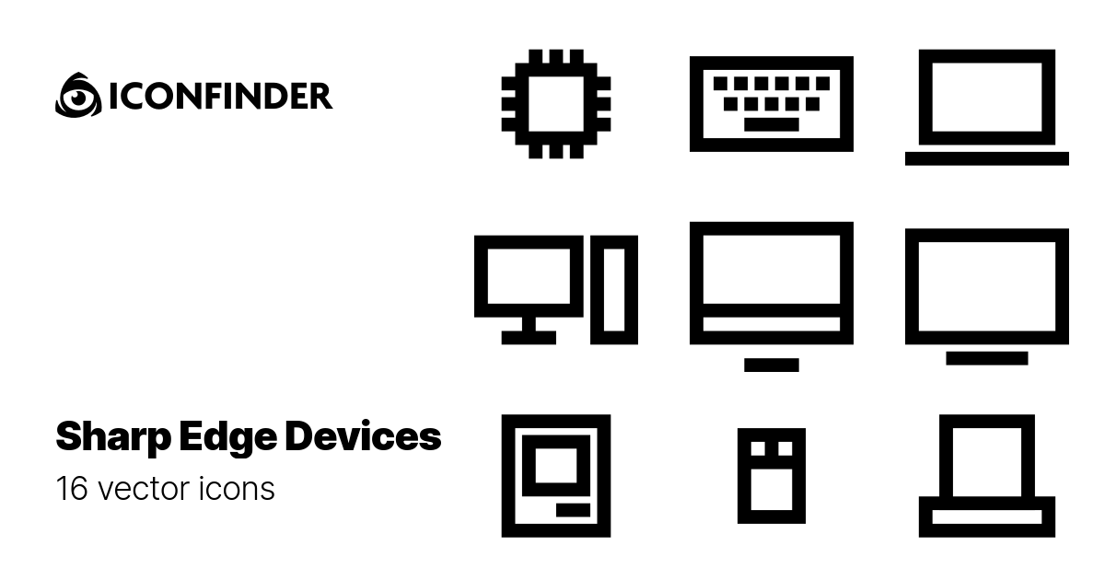
FedNLP: focus of this work
Transformer Models
Federated Fine-tuning
BERT, DistilBERT, BART, GPT, etc
Text Clssification.
Fine-tuning
Mobile devices
Seq. Tagging
Fine-tuning
Deployment
Pre-training
…
…
Fine-tuning
Text Generation.
…
Private, geo-distributed
Public, centralized
Cloud
Cloud&Clients
Clients
Notes:
So let’s go back to the NLP topic. //
Much success of modern NLP comes from its training workflow as illustrated in the Figure //
First, the pre-training phase builds a foundation model on large public dataset.//
Second, the fine-tuning phase further tailors the pre-trained model on private data.//
Finally, the fine-tuned models are deployed to clients for inference.//
Our paper focuses on the second step, that is federated fine-tuning of NLP models.
---
Modern NLP models show compelling use cases on mobile devices. Examples include sentiment analysis, QA, and auto completion. Through careful engineering, inference with the NLP models is demonstrated to be affordable on mobile devices.
Step 1 and 3 has been widely researched, while step 2 receives rather rare attention.

Slide 4
Is FedNLP practical on todays’ mobile platforms?
Notes:
Despite many FedNLP algorithms are proposed, // it remains unclear whether FedNLP is truly practical on today's mobile platforms.

Slide 5
Observation 1: Transformer-based NLP models are highly costly.
Observation 2: FedNLP task is extremely slow.
Observation 3: Network transmission dominates the training delay on high-end devices.
Observation 4: Existing techniques are inadequate for FedNLP.
Notes:
We conducted preliminary experiments to gain a deeper understanding and to shape the design of our system. //
Our first observation is that // Transformer-based NLP models can be quite expensive in consideration of the number of parameters and the training complexity. //
And our second observation is, // The FedNLP fine-tuning is very slow. //
And we dig deeper to find its reason, it shows that the network transmission delay// is the major bottleneck.//
And existing techniques such as layer freezing are inadequate for FedNLP//

Slide 6


Key Building Block: Pluggable Adapters
Table 1: Computation and communication cost of inserting adapters into each transformer block (width=32) and full model tuning. Batch size: 4. Device: Jetson TX2.
Tiny adapters (less than 1M for each) are inserted to pre-trained Transformers.
Only adapters are updated during training, most of Transformer parameters are freezing.
Notes:
Based on these observation, we came to think about//, Is there a way to reduce network transmission without compromising the accuracy?//
So we retrofit adapters – a recently proposed technique to achieve parameter efficiency in machine learning.
These adapters insert small, trainable modules into pre-trained transformers.
And during fine-tuning, only these adapters are updated, other parameters like attention, feed forward are all freezing
While simply inserting adapter into transformers layers already offers certain advantages, such as reducing network traffic by three orders of magnitude, it still leaves a huge room for improvement and a few technical challenges to overcome.

Slide 7
Challenge: Large Adapter Configuration Space
…
Number of adapters: Tuning depth
Bottleneck size: Tuning width
Transformer
Transformer
Transformer
Small bottleneck dimension
Large bottleneck dimension
Null
Adapter
Adapter
Add & Norm
Add & Norm
Add & Norm
Hidden State Dimen.
Hidden State Dimen.
W_{up}
W_{up}
Feed Forward
Feed Forward
Feed Forward
D.
Dimen.
W_{down}
W_{down}
Add & Norm
Add & Norm
Add & Norm
Hidden State Dimen.
Hidden State Dimen.
Attention
Attention
Attention
Layer 0
…
Layer i
…
Layer 11
Adapter Structure: Bottleneck
Different adapter configurations (depth, width) result in a variety of convergence delays, up to 4.7× gap.
Notes:
The first challenge is the large adapter configuration space.
instead of simply inserting adapters into all layers in a default size. We could insert adapter with different size to different layers， right?.
We define two metrics to describe it, the first metric adapter depth is the number of adapters inserted into transformers.
And we define adapter width as the bottleneck dimension located between two projection layers within the adapter.
The combination of the two factors depth and width introduces a huge configuration space.
And choosing the optimal adapter configuration is vital, // as different configurations can lead to up to a 5× gap in convergence performance. //
D. 和 Dimen.的区别是什么？
在这个session下，局部最优
是第一个FedAdapter的工作上的，他们的实现是

Slide 8
Challenge: No Silver Bullet Configuration
The optimal configuration can be switched across FL rounds.
Configuration varies across many factors: targeted accuracy, targeted NLP tasks and client resources.
Across different target accuracy and target FedNLP tasks, the optimal adapter configuration (depth, width) varies. Model: BERT; device: Jetson TX2.
The optimal adapter configuration (i.e., best time to-accuracy) for different target accuracy (ratio to the full convergence accuracy) and different datasets.
Notes:
And the second challenge is, the optimal adapter configuration is hard to find.//
As shown in left Figure, the best configuration can be switched across federated learning rounds.
For example, at the early round, a simpler adapter configuration might boost performance more quickly, but it often plateaus at a low accuracy. A more complex configuration with deeper and wider adapter could help to push beyond it, so as to reach a higher accuracy.
Another key observation from our extensive experiments is that there is no optimal configuration for all tasks.
Even with the same pre-trained model, there are many factors that decide which configuration will lead to the quickest convergence. //
在这个session下，局部最优
是第一个FedAdapter的工作上的，他们的实现是

Slide 9
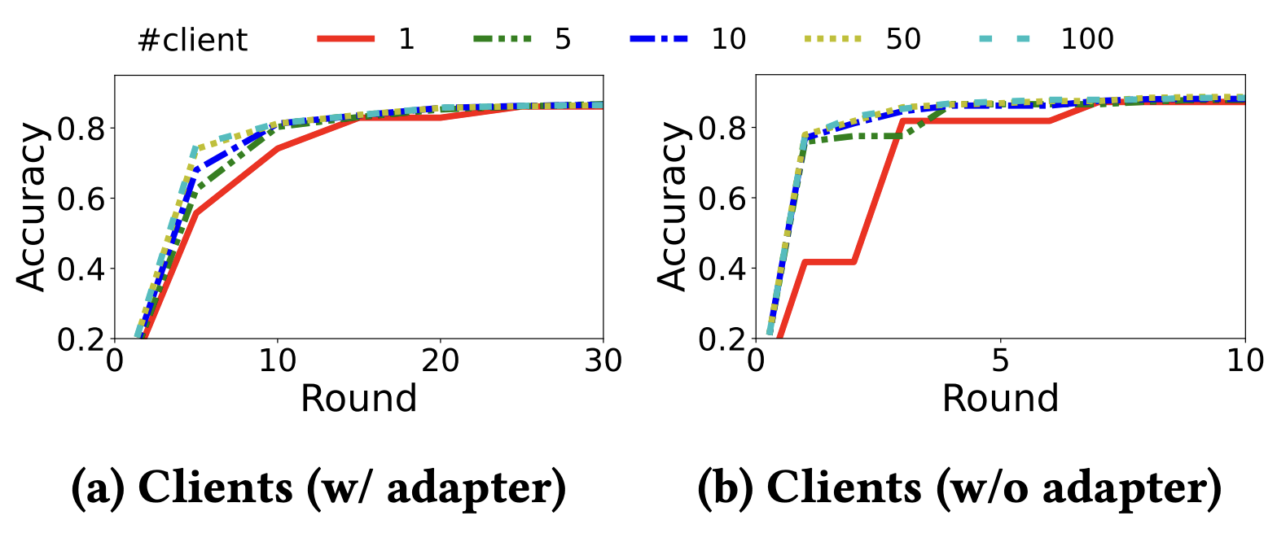
Design: Online Configurator
Progressive training: curriculum upgrading adapter configuration.
Sideline trails: identifying timing and direction to upgrade configuration.
Group 3: Clients
Server
Management
Group 2: Clients
1
T&E Scheduler
Group 1: Clients
Aggregator
Adapter
Adapter
Pre-Trained
Model
Adapter
Adapter
Pre-Trained
Model
Adapter
9
8
7
6
2
Branch Generator
5
5
8
Adapter
Device
Database
3
Adapter
Receiver
Adapter
Client Selector
4
When and how to upgrade the configuration?
Notes:
So here is our design to tackle those challenges.
Inspired by the observation that the suitable adapter configuration evolves during training, we decided to progressively upgrade the adapter configuration.
That is to say, during federated fine-tuning, we start from a simple and cheap adapter configuration to boost accuracy performance at the early stage.
Then if the model demands more complex information, we will use stronger adapter like deeper or wider adapters to meet this//
Now here comes another question? How does the system know it’s time to upgrade the adapter configuration and which direct should it take? Deeper or wider?
So we propose an intuitive approach named sideline trials.
The key idea is to ask extra participant clients to try different tuning depths and widths simultaneously, and make a decision on whether and where to upgrade based on the tested accuracy of different directions.
Its rationale is that federated learning has a scalability issue according to our experiments, that means like tens of clients is enough for per round training, including more clients only bring little benefits.
So we ask those clients ready for training to help our training in a sideline way for finding a better configuration.

Slide 10
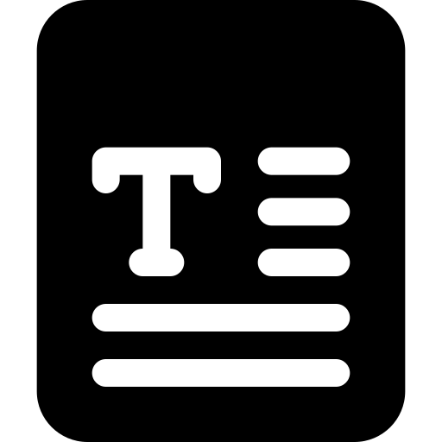
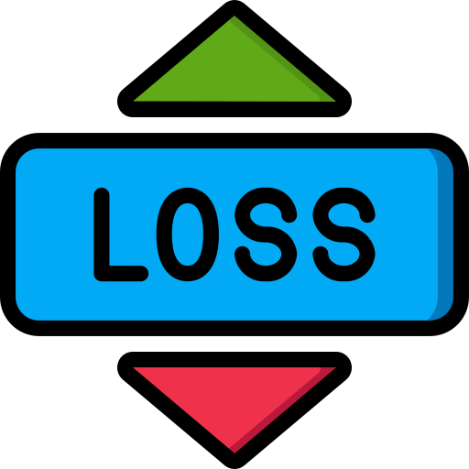
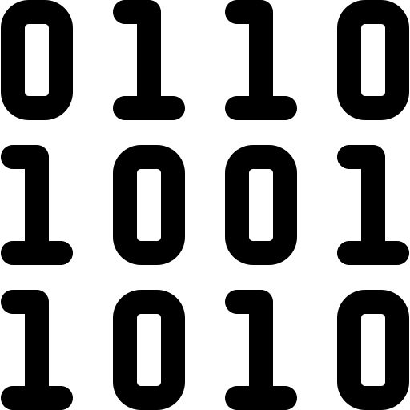
Further optimization: Activation Cache
An unique opportunity: Most of the Transformer parameters are freezing.
w/o cache
Input
Layer
freezing
Adapter tuning
Transformer
Transformer
Transformer
Transformer
Transformer
Transformer
Output
Intermediate activations
Label
Notes:
Okay ,now, using adapter significantly reduces the network cost, exposing client-side computation as the next major bottleneck for fast model training.
So we introduce a further optimization to reduce computation cost.
While our adapters are preferred to be inserted into the top transformer layers, allowing us to reduce the backward computations by early-stopping. (click)
But it does not address the computation cost at forward pass. (click)
Fortunately, we exploit an unique opportunity in our FedNLP system, that is Most of the Transformer parameters are freezing and the selected device tends to execute local training on the same set of local samples for many rounds.
So those intermediate activations could be reused until Our system switches the tuning depth.
---
把activation cache到disk上，不会导致io的问题嘛？？
Caching the activations takes extra storage, i.e., 𝑠𝑒𝑞𝑙𝑒𝑛 ×𝑛 ×𝐵𝑆 per batch, where 𝑠𝑒𝑞𝑙𝑒𝑛 is the max sequence length (default 256), 𝑛 is the transformer’s internal feature size (default 768), and 𝐵𝑆 is the batch size (default 4). The cache is reloaded from disk per minibatch, taking no more than tens of ms on embedded flash and incurs less than 2% overhead. The total cache size is also proportional to the number of batches samples per client (typically dozens). Assuming 100 training samples, the storage cost is calculated to be around 93.75MB. Such cost is no more than 1% of the storage of a modern mobile/embedded device, ranging from tens to hundreds of GBs. Note that the cache can be cleared once the FL process finishes.

Slide 11

Further optimization: Activation Cache
An unique opportunity: Most of the Transformer parameters are freezing.
w/o cache
Input
Layer
freezing
Adapter tuning
Transformer
Transformer
Transformer
Transformer
Transformer
Transformer
Output
Intermediate activations
Label
Disk Cache
w/ cache
Notes:
so we cache the output of the last fixed layers.
For the next time device is selected, it could load the cached output// and feed it into the training process// instead of starting from scratch again.
---
Since layers are freezing, we could freeze those same intermediate activation as well.
把activation cache到disk上，不会导致io的问题嘛？？
Caching the activations takes extra storage, i.e., 𝑠𝑒𝑞𝑙𝑒𝑛 ×𝑛 ×𝐵𝑆 per batch, where 𝑠𝑒𝑞𝑙𝑒𝑛 is the max sequence length (default 256), 𝑛 is the transformer’s internal feature size (default 768), and 𝐵𝑆 is the batch size (default 4). The cache is reloaded from disk per minibatch, taking no more than tens of ms on embedded flash and incurs less than 2% overhead. The total cache size is also proportional to the number of batches samples per client (typically dozens). Assuming 100 training samples, the storage cost is calculated to be around 93.75MB. Such cost is no more than 1% of the storage of a modern mobile/embedded device, ranging from tens to hundreds of GBs. Note that the cache can be cleared once the FL process finishes.

Slide 12
Evaluation: Setup
Implementation
FedNLP^{[1]}
AdapterHub^{[2]}
Setups
3 devices
2 models (BERT & DistilBERT)
4 datasets
Baselines
Vanilla Fine-Tuning (FT)
FineTuning-Quantized (FTQ)
LayerFreeze-Oracle (LF_{𝑜𝑟𝑎𝑐𝑙𝑒} )
LayerFreeze-Quantized-Oracle (LFQ_{𝑜𝑟𝑎𝑐𝑙𝑒} )
[1] Yuchen Lin B, He C, Zeng Z, et al. FedNLP: Benchmarking Federated Learning Methods for Natural Language Processing Tasks[J]. Findings of NAACL, 2022.
[2] Pfeiffer J, Rücklé A, Poth C, et al. AdapterHub: A Framework for Adapting Transformers. Proceedings of the 2020 Conference on Empirical Methods in Natural Language Processing: System Demonstrations. 2020: 46-54
Notes:
So that’s all of our design, and we have fully implemented Our system atop the open-sourced repository for easy reproducible.
Our experiments are conducted in an emulation manner on GPU servers and three kinds of development boards：that is jetson tx2 (as a strong edge device with gpu), nano as it light-weight version, and rpi as a kind of wimpy devices.
(with similar hardware capacity to mainstream mobile devices.
And we evaluate Our system on four NLP datasets and two models compared to 4 baseline(, including vanilla fine-tuning, quantization, layer freezing and their combination.

Slide 13
Evaluation: End-to-end Performance
Our system reduces model convergence delays significantly.
260×
Table 1: Elapsed training time taken to reach different relative target accuracy. NLP model: BERT-base. Unit: Hour.
Notes:
So first, Let's look at the time-to-accuracy of our system. // Traditional federated fine-tuning takes hours to converge on one task. //
In comparison, we complete all tasks within only a few hours or even less, with a speedup of up to two hundred and sixty times. //
(This boost is due to our sideline upgrading mechanism in adapter configurations and the activation cache. //
Even against strong baselines like layer quantization, freezing or their oracle orchestrating, our system still stands out.
---
Specially, our system could reach a lower but useful accuracy quicker, having up to two hundred and sixty times speedup. This is because Our system employs an upgrading mechanism on adapter configuration which enables fast boosting of the training accuracy.
---
On a diverse set of 4 NLP datasets, Our system reduces the training (model convergence) delay from 31.1– 124.3 hours to 0.2–4.5 hours (up to 155.5× reduction) as against a vanilla fine-tuning approach.
Compared to more advanced methods such as model quantization [85], layer freezing [24, 50], and their combination, Our system still brings 4×–48× speedup.

Slide 14
Evaluation: System Scalability
Our system outperforms baselines under different network environments
It outperforms baselines on various client hardware.
112.5×
9.2×
79.2×
48.3×
7.0×
15.7×
Fig. 1: Model convergence delays under different network bandwidths. Training targets 99% relative target accuracy.
Fig. 2: Model convergence delays with a variety of client hardware. ‘Heterogenous’ means a mixture of heterogeneous hardware capacity.
Notes:
Now let’s see Our system’s performance under different settings. The left figure reports that our system consistently outperforms baselines across network conditions, Especially for the poor network condition.
And the right figure further underscores our system’performance across different device capacities. //

Slide 15
Evaluation: System Cost
Our system is resource-efficient.
It saves up to 220.7× network traffic. (Fig. 1)
It reduces up to 32.2× energy consumption. (Fig. 2)
It nontrivially reduces the memory usage. (Fig. 3)
Fig. 1: Network traffic (downlink and uplink) of all 15 client devices.
Fig. 2: Per-client average energy consumption, normalized to that of ours.
Fig. 3: Peak memory usage of a client device.
Notes:
The last part of our evaluation is the system cost.
Network traffic reduction is the most significant benefits of our system, because it only needs to transfer the tiny adapters. It saves more than two hundred times traffic compared to vanilla federated fine-tuning.
Our system isn't just about efficient data transfer; it's also energy-efficient and memory-efficient
// because we don't compute gradients for many parameters and don't store related activations,.

Slide 16

Conclusion
Our system is a federated learning framework for fast NLP model fine-tuning.
It uses adapter as the only trainable module in NLP model to reduce the training cost.
To identify the optimal adapter configuration on the fly, it integrates a progressive training paradigm and trail-and-error profiling technique.
It can reduce FedNLP’s model convergence delay to no more than several hours, which is up to 155× faster compared to vanilla FedNLP and 48× faster compared to strong baselines.
Thanks for listening!
<Efficient Federated Learning for Modern NLP>
Dongqi Cai, Yaozong Wu, Shangguang Wang, Felix Xiaozhu Lin, Mengwei Xu
Scan for our code!
Notes:
In conclusion, Our system is a federated learning framework for fast NLP model fine-tuning.
It uses adapter as the only trainable module in NLP model.
To identify the optimal adapter configuration, our system integrates a progressive training paradigm and trail-and-error profiling technique.
Finally, our system can reduce FedNLP’s model convergence delay to no more than several hours.
That’s all, thank you for listening.
And I’ll be happy to answer any questions.

Slide 17
Appendix

Slide 18
Evaluation: Key deign
Our key designs contribute to the results significantly.
1.2×
1.1×
~
7.1×
10.1×
1.7×
3.5×
1.3×
2.3×
2.4×
3.3×
2.1×
Fig. 1: Model convergence delays with and without our system’s key designs, showing their significance.
Notes:
Such a huge benefits come from each of our design: using adapters, automatic adapter configurator, and caching.
First, naïve use of adapters offer huge improvement in some cases.
Our configurator helps to find the oracle adapter configuration, slashing training latency significantly. //
Then // employing the activation cache technique further reduces the convergence latency via reducing the on-device training time.
---
What is worse, on a wimpy device RPI, naive use of adapters even slows down the convergence performance, because for the wimpy devices, not only communication overhead, but also the computation overhead is the bottleneck. For which, naïve adapter could not solve.
---
Our key designs contribute to the results significantly: compared to a hand-picked configuration which requires exhaustive offline search, Our system’s online configurator reduces the model convergence delay by 4.6×; Our system’s caching
reduces the delay by 3.3×.

